Slide 1




BEHAVIORAL ANALYTICS AND ANOMALY DETECTION
Geraldine : Research Lead & Project Architect
Janine : Designer & Content Researcher
Natsuki : Content Organizer & Documentation Lead
Venus : Data Analyst & Modeling Specialist
PAGE 1

Slide 2


INTRODUCTION
With the rise in cyber threats, data science has emerged as a powerful ally in the field of cybersecurity. It offers advanced tools and methodologies for detecting, analyzing, and mitigating threats in real-time. This project explores how behavioral analytics and anomaly detection techniques are applied to strengthen cybersecurity measures across various industries.
PAGE 2

Slide 3
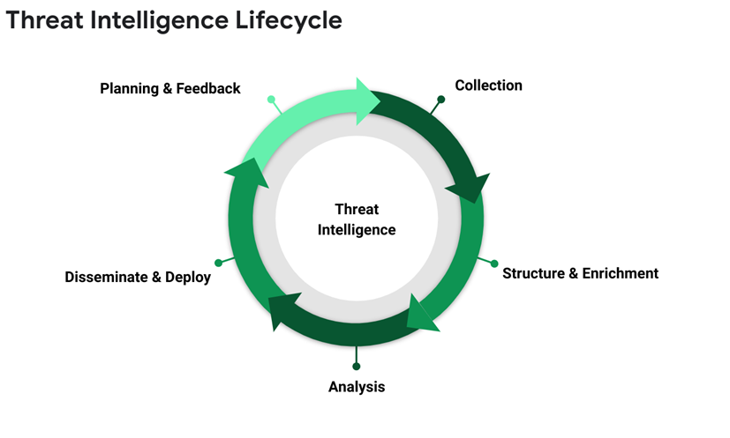
OVERVIEW: WHAT IS DATA SCIENCE IN CYBERSECURITY?
1.
•Data Science refers to using statistical analysis, machine learning, and data processing techniques to extract insights from data.
2.
•In cybersecurity, we apply these methods to analyze log files, network traffic, or user behavior to detect threats, anomalies, or attacks.
PAGE 3

Slide 4


PROJECT OBJECTIVES
Understand how data science enhances cybersecurity
Explore behavioral analytics and anomaly detection
Showcase real-world case studies
Highlight tools, models, and algorithms used
Discuss challenges and future trends
PAGE 4

Slide 5


CORE CONCEPTS IN CYBERSECURITY DATA SCIENCE
1.
BEHAVIORAL ANALYTICS
2.
ANOMALY DETECTION
Analyze user behavior and detect deviations
Use cases: Insider threat, fraudulent logins, risk scoring
Identify unusual patterns or outliers
Techniques: Isolation Forest, SVM, Autoencoders, Time Series
PAGE 5

Slide 6

METHODOLOGIES & ALGORITHMS
Data Collection: Server logs, traffic, app usage
Preprocessing: Cleaning, normalization, feature extraction
Modeling: Logistic Regression, KMeans, DBSCAN, Random Forest, NLP
PAGE 6

Slide 7
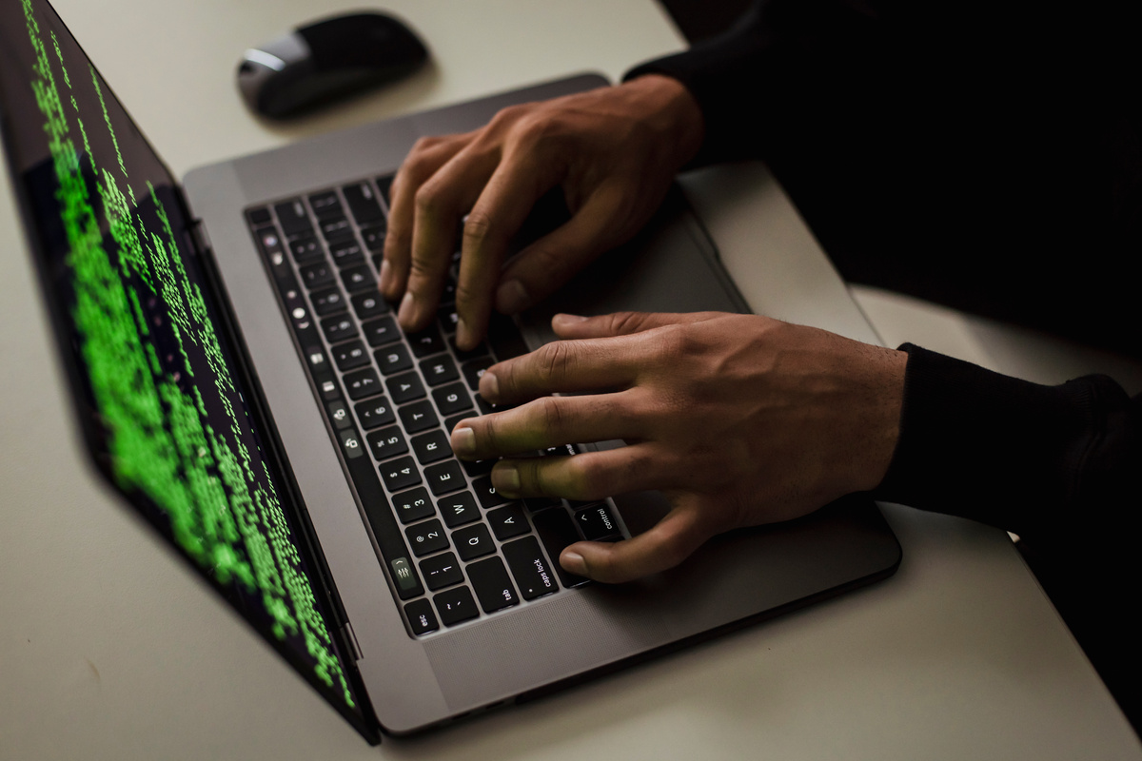
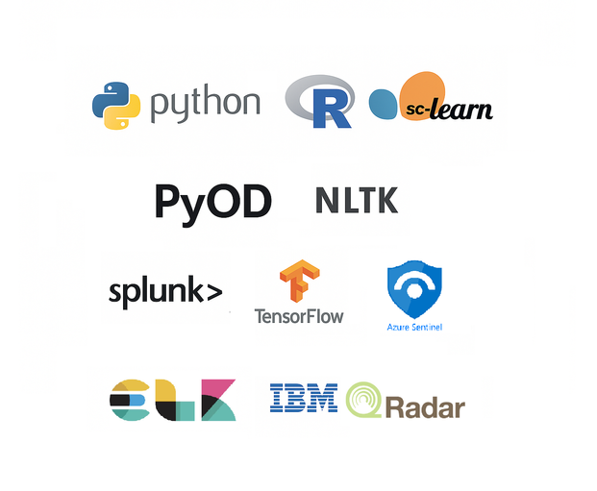
TOOLS & TECHNOLOGIES
1.
LANGUAGES
Python,SQL
2.
LIBRALIES
Pandas, Seaborn, Plotly
ML: Scikit-learn, PyOD
3.
DATA SOURCES
Kaggle
PAGE 7

Slide 8


CASE STUDY EXAMPLES
User Behavior Analytics in Finance Industry:
Use Case:
Detecting insider threats and fraudulent behavior in a financial institution using behavioral profiling and anomaly detection.
Approach:
Collected user activity logs (logins, access time, transaction size)
Built behavior profiles using historical data
Applied Isolation Forest to detect deviations from normal patterns
Outcome:
📈 Achieved 85% fraud detection accuracy
🚨 Early detection of risky behavior before incidents occurred
PAGE 8

Slide 9
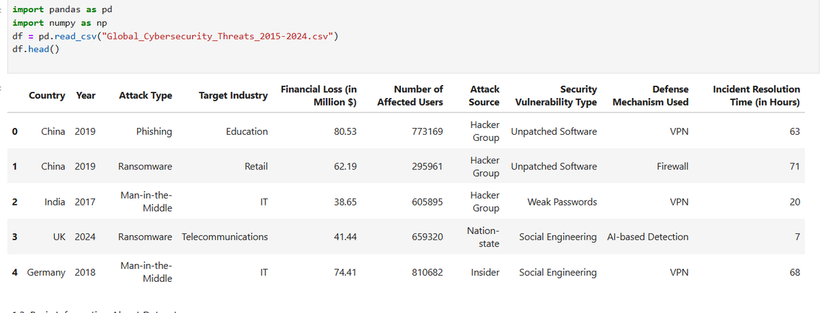

✅ PHASE 1: Preprocessing & EDA (Python / Jupyter Notebook)
🔹 Step 2: Exploratory Data Analysis (EDA)
Use Pandas, Matplotlib, Seaborn, Plotly:
Top 10 attack types by frequency
Yearly trends in attacks
Financial loss and user impact per attack type
Attack sources per industry
Incident resolution time distribution
Country-wise heatmap of attacks
🔹 Step 1: Data Cleaning
Check for missing values, duplicates
Normalize column names
Convert data types if needed

Slide 10
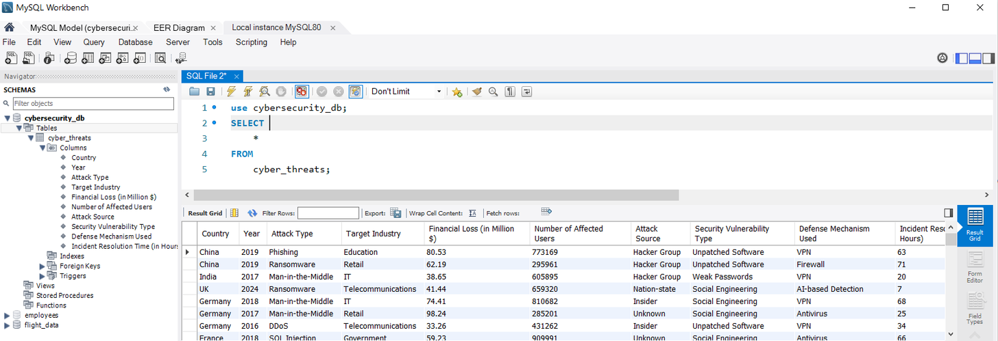
✅ PHASE 2: ETL into SQL Database
🔹 Step 5: SQL Queries
Top 5 industries by loss or attacks
Year-over-year trends
Rare (anomalous) attack types
Avg resolution time by defense mechanism
🔹 Step 3: SQL Schema Design
Example schema:
Countries
Industries
Attack_Types
Cyber_Incidents (includes all metrics per row)
🔹 Step 4: Load Data into SQL
MySQL via Python (SQLAlchemy, sqlite3)

Slide 11
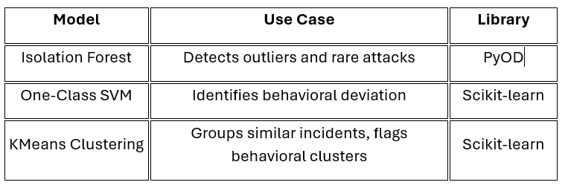
✅ PHASE 3: Modeling (Anomaly Detection & Behavioral Analytics)
with Isolation Forest, One-Class SVM, and KMeans
🔹 Step 6: Feature Engineering:
• Convert Attack Type, Industry, Source to numeric (OneHot/Label Encoding)
• Normalize values like Loss, Users, Time
🔹 Step 7: Modeling Techniques:
•Applied ML models using :
- Isolation Forest – Outlier detection (PyOD)
- One-Class SVM – Behavioral deviation (Scikit-learn)
- KMeans – Cluster incidents by similarity (Scikit-learn)

Slide 12
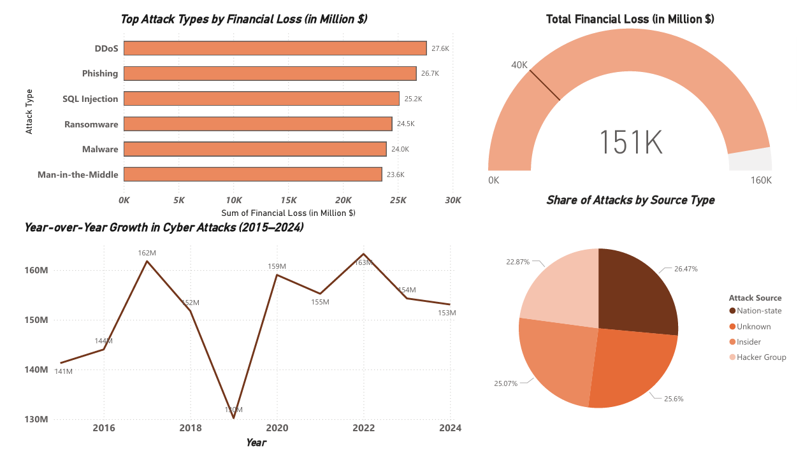
🔹 Step 8: Power BI Dashboard Ideas
Bar Chart: Top Attack Types by Financial Loss
Line chart: YOY-Yearly trends in loss or attack volume
Gauge Chart: Total financial Loss
Pie chart: Attackes by Source Type
✅ PHASE 4: Visualization in Power BI

Slide 13
✅ PHASE 5: Interpretation & Reporting
🔹 Step 9: Key Questions Answered
Answer questions like:
What are the most damaging attack types?
Which industries are most vulnerable?
Are certain countries seeing increasing trends?
What patterns show potential anomalies?
🔹Step 1o: Reporting
This project proves the value of applying machine learning in cybersecurity. By using anomaly detection and clustering, we flagged risky incidents that deviate from normal patterns. With SQL and Power BI, we transformed data into real-time insights for proactive defense.

Slide 14

🔹 Data Imbalance
Most data is normal behavior; attacks are rare. This makes it hard for models to detect threats accurately.
🔹 False Positives/Negatives
Too many false alerts can overwhelm teams (false positives), while missed threats (false negatives) can cause harm.
🔹 Privacy Concerns
Monitoring user behavior can raise privacy issues. Data must be handled responsibly and follow privacy laws.
🔹 Real-Time Processing
Cyber threats happen fast—systems need to detect and respond instantly, which demands strong computing power.
CHALLENGES
PAGE 16

Slide 15


FUTURE TRENDS
Future Trends in Cybersecurity
AI-Driven SOCs: Automate threat detection and response for faster security operations.
Federated Learning: Train models across systems without sharing data, improving privacy.
Explainable AI: Makes AI decisions easier to understand and trust.
Blockchain: Secures data with tamper-proof, decentralized records.
PAGE 17

Slide 16
CONCLUSION
Data science has greatly enhanced cybersecurity by enabling proactive threat detection. Behavioral analytics and anomaly detection are crucial tools in securing digital environments. Continued innovation and ethical practices will ensure robust defense systems.
1.
PAGE 18

Slide 17
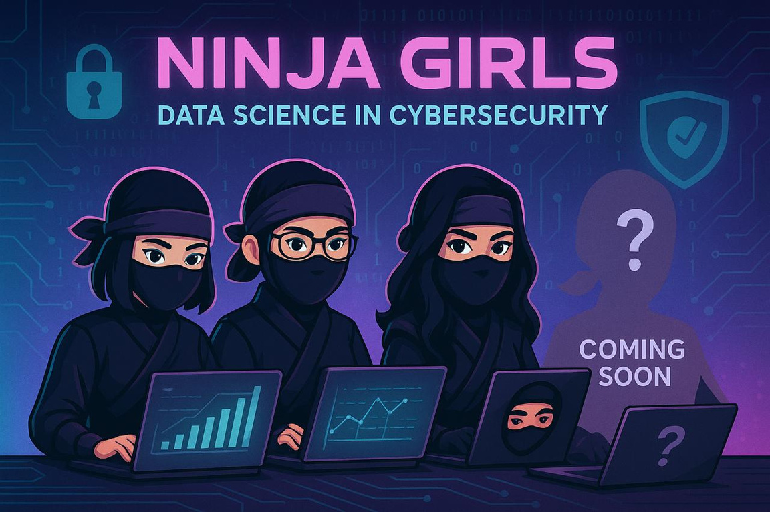

THANK YOU
PAGE 19

